Slide 1
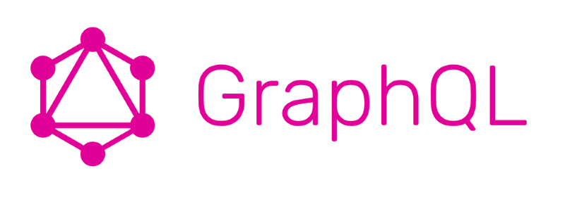
Modern Web APIs with GraphQL
Hélder Vasconcelos
Luis Gonçalves

Slide 2
Outline
Who are we
What is a Web API
Web API Technologies
What is GraphQL
GraphQL advantages
GraphQL vs REST
Languages that implement GraphQL
Demo - build GraphQL Api
Resources
Q & A

Slide 3
What is a Web API?
An Application Programming Interface – is software programmed contract written to function as a communication bridge between the web applications running on the browser and the backend or cloud services.

Slide 4
Web APIS Technologies
XML Based RPC APIs (SOAP)- a XML based protocol Introduced in Late 90’s.
AJAX - Introduced in 2005 soon became a popular approach for making web sites dynamic, giving birth to the "Web 2.0" concept.
REST (Representational State Transfer) - Introduced on 2000 , uses a passing of resource representations, as opposed to messages or function calls.
GraphQL - based on schema types. It was developed internally by Facebook and released as open source on 2015.

Slide 5
What is GraphQL?
GraphQL is just a web protocol that specifies the way we build and query remote APIs using a Tree/JSON like syntax.
Based on a strongly typed language - GraphQL Schema Definition Language (SDL).
It allows the client to specify exactly what data it needs from a model
reactorHubNews {
title
description
}
type Post {
title: String!
description: String!
}

Slide 6
What is GraphQL?
A protocol that allows the client to specify exactly what data it needs from a model.
It allows to aggregate data from multiple relations in a single query.
It allows the client to specify exactly what data it needs from a model
It allows to aggregate data from multiple relations in a single query
It allows to aggregate data from multiple sources
posts {
title
}
posts {
title
description
user {
name
}
}

Slide 7
GraphQL Type System - Built in scalar types
Int - An Integer type, example 10
Float - Floating point number , example 3.43
String - A sequence of characters , example “Hello World”
Boolean -
ID - Object identifier

Slide 8
GraphQL Type System - User Defined Types
GraphQL uses types to ensure the clients know the fields supported by a resource. The types are defined by the user following the GraphQL SDL specification
type Post {
title: String!
description: String!
author: User!
}
type User {
fullName: String!
email: String!
}

Slide 9
GraphQL Query
Used to fetch data from the server using the GraphQL SDL syntax.
Describe what data the requester wishes to fetch from whoever is fulfilling the GraphQL query.
query reactorNews {
posts(sortedBy: createdDesc) {
title
description
author {
fullName
}
}
}

Slide 10
GraphQL Mutation
Used to change resources data or execute actions on the server
Client specifies the arguments and the action to be executed and at the end receives a response or a resource updated
mutation createPost {
createPost({
title: “Reactor is celebrating a party”
Description: “Beer, sparkling water and much more….:)” })
{
id
title
}
}

Slide 11
GraphQL Subscription
Used to get realtime resource or data updates
Users get a notification every time the resource subscribed gets updated or changed.
subscription newSubscriber {
newsLetterSubscriberCreated{
id
subscriber {
fullName
email
}
createAt
}
}

Slide 12
GraphQL Advantages
You get the data you request and need for a particular scope
Excellent developer tooling and experiences since the specification defines API introspection
Only one endpoint to connect,
Example POST api.reactorhub.com /graphql/api

Slide 13
GraphQL vs REST
GraphQL has only one url/endpoint
In REST, the layout and size of data returned is determined by the server . The server has a predetermined amount of properties and relations that sends on a call.
In REST, to retrieve relational data you need to make multiples API calls making the data data rendering more

Slide 14
GraphQL implementations
Server:
Client:
C# / .NET
Clojure
Elixir
Erlang
Go
Groovy
Java
JavaScript
PHP
Python
Scala
Ruby
C# / .NET
Clojurescript
Go
Java / Android
JavaScript
Swift / Objective-C iOS
Python

Slide 15
Demo
Let’s create a GraphQL API in node.js
Create GraphQL server with ApolloServer
Use gql to define schema ( typedefs )
types
Queries
Mutations
Define resolvers.
Show playground to explore and test API
Notes:
Example Ideas for the demo:
Reactor API
list all startups
List reactor members
List events/talks

Slide 16
Resources
Sites
GraphQL ( https://graphql.org/ )
GraphQL Weekly newsletter ( https://www.graphqlweekly.com/ )
GraphQL Cheat Sheet ( https://github.com/sogko/graphql-schema-language-cheat-sheet )
Apollo ( https://www.apollographql.com/ )
Prisma ( https://www.prisma.io/ )
Hasura ( https://hasura.io/ )
GraphQL Yoga ( https://github.com/prisma/graphql-yoga )
Podcasts
https://graphqlpatterns.simplecast.fm/
https://graphqlradio.com/ ( last episode > 1 year ago )
Books
The Road to GraphQL (free ebook)

Slide 17




Thanks! Any Questions ?
www.taikai.network
luis@taikai.network @luisfigoncalves
helder@taikai.network @heldervasc

